Slide 1
Multithreading

Slide 2
Multithreading
to implement parallelism
threads programming interface has been specified by the IEEE POSIX 1003.1c standard

Slide 3
What is a thread
independent stream of instructions that can be scheduled to run
Programming Definition
Function that runs independently from its main program

Slide 4
How a Process Looks like?

Slide 5
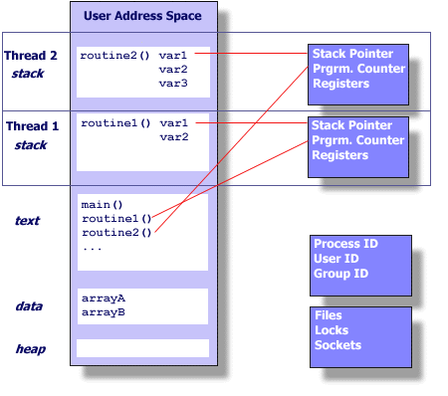
How Multi-threaded process looks?
a thread maintains its own:
Stack pointer
Registers
Scheduling properties (such as policy or priority)
Set of pending and blocked signals
Thread specific data.

Slide 6
Suitable Candidates for threading
Work that can be executed, or data that can be operated on, by multiple tasks simultaneously
Block for potentially long I/O waits
Use many CPU cycles in some places but not others
Must respond to asynchronous events
Some work is more important than other work (priority interrupts)

Slide 7
Designing threads
Common models for threaded programs:
Manager/Worker: manager assigns work to other threads, the workers. Manager handles input and hands out the work to the other tasks.
Pipeline: task is broken into a series of sub-operations, each handled in series but concurrently, by a different thread.

Slide 8
Thread creation
Types: pthread_t – type of a thread
Some calls:
int pthread_create(pthread_t *thread,
const pthread_attr_t *attr,
void * (*start_routine)(void *),
void *arg);
int pthread_join(pthread_t thread, void **status);
int pthread_detach();
void pthread_exit();
No explicit parent/child model, except main thread holds process info
Call pthread_exit in main, don’t just fall through;
Most likely you wouldn’t need pthread_join
status = exit value returned by joinable thread
Detached threads are those which cannot be joined (can also set this at creation)

Slide 9
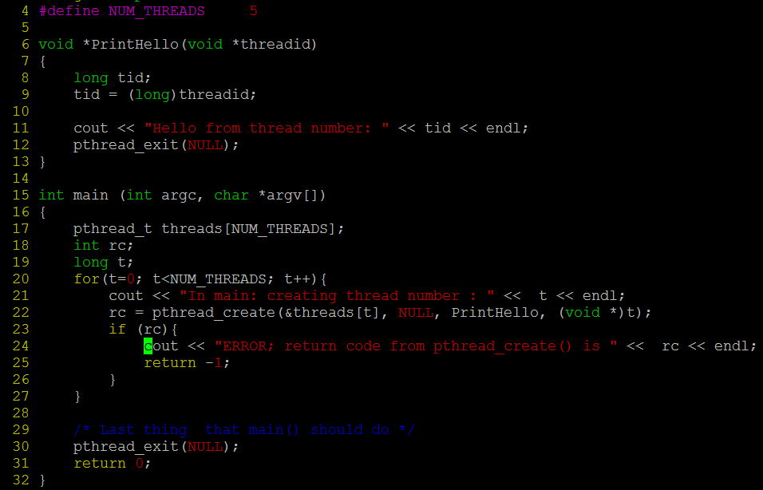
Hello World from Threads!

Slide 10
Output
In main: creating thread number : 0
In main: creating thread number : 1
In main: creating thread number : 2
Hello from thread number: 0
Hello from thread number:1
In main: creating thread number : 3
Hello from thread number: 2
In main: creating thread number : 4
Hello from thread number: 3
Hello from thread number: 4

Slide 11
Hands on: Run the without_joining_threads.cpp and joining_threads.cpp

Slide 12
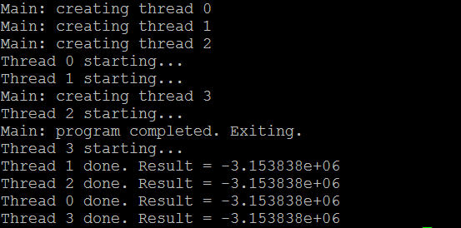
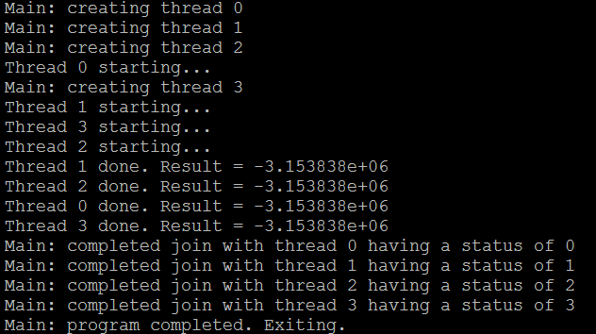
Without Joining
Joining threads

Slide 13
Passing Arguments to Thread

Slide 14
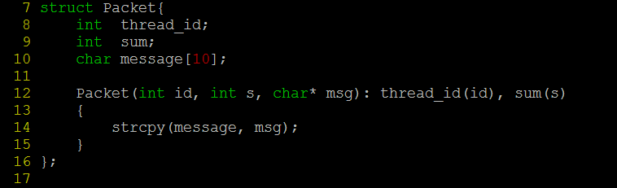
Passing argument to thread

Slide 15
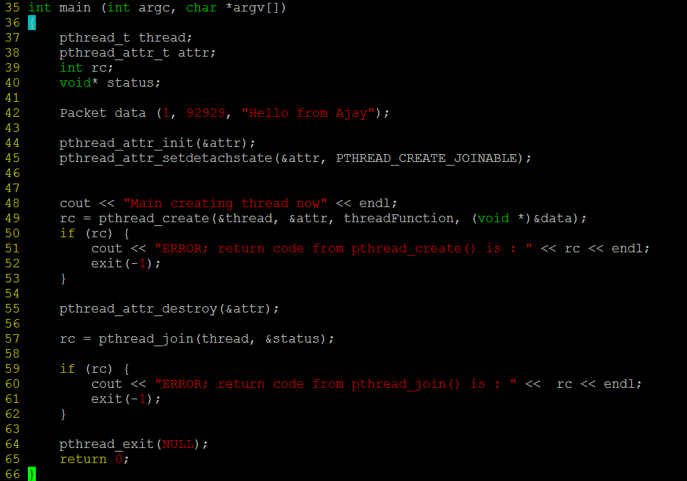
main()

Slide 16
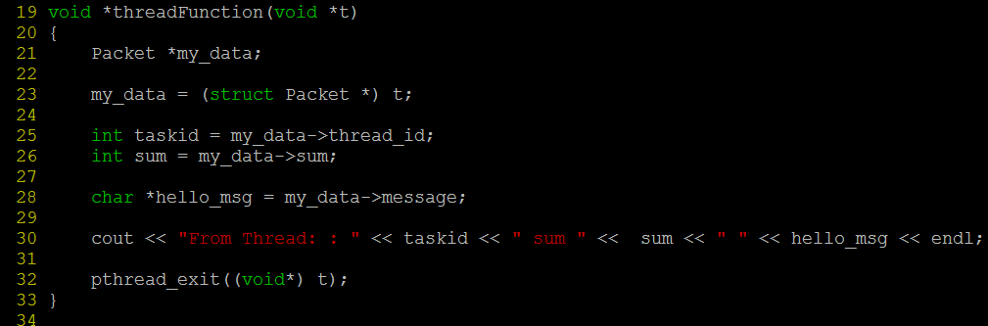
The threadFunction

Slide 17
Threads in a class: a common approach

Slide 18
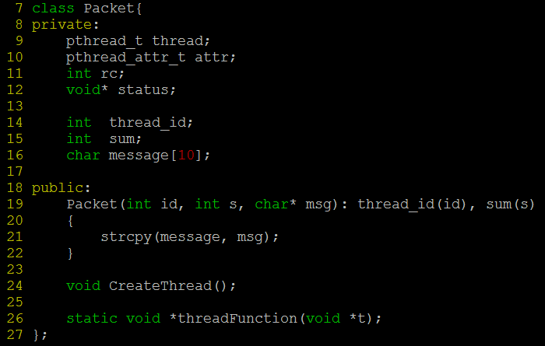
Threads in a class - 1

Slide 19
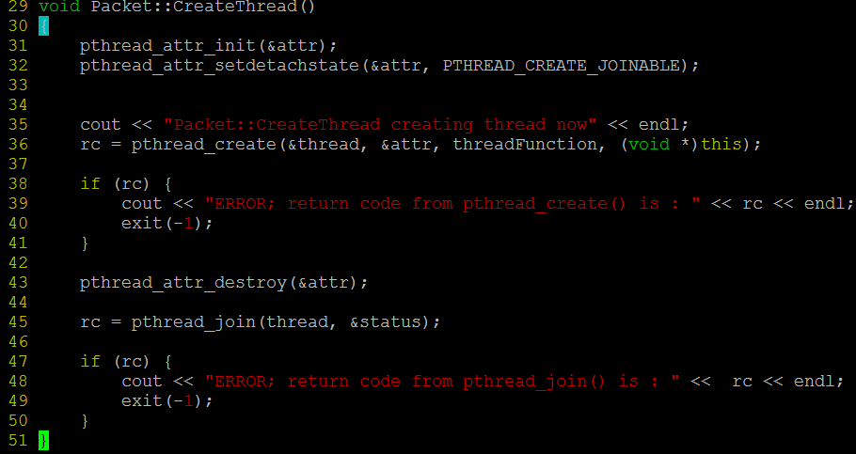
Threads in a class - 2

Slide 20
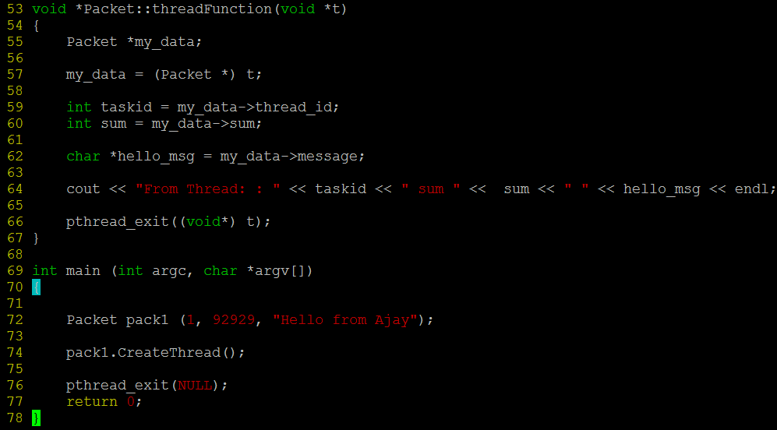
Threads in a class - 3

Slide 21
Mutex: need of Synchronization

Slide 22
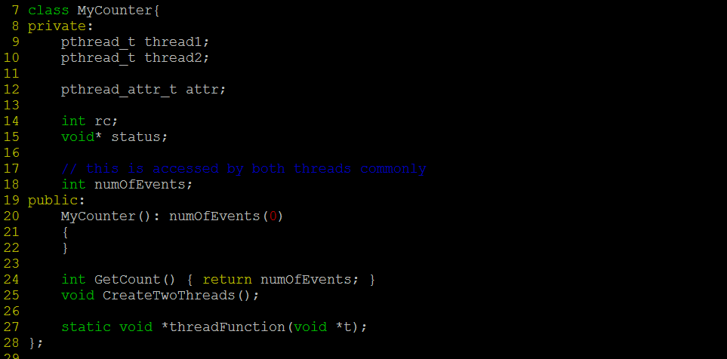
class declaration

Slide 23
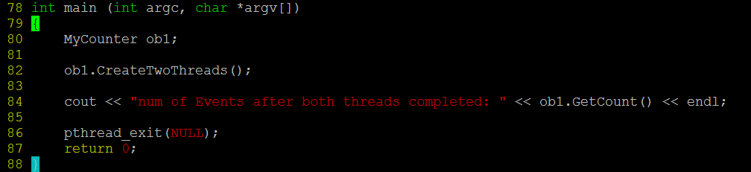
main()

Slide 24
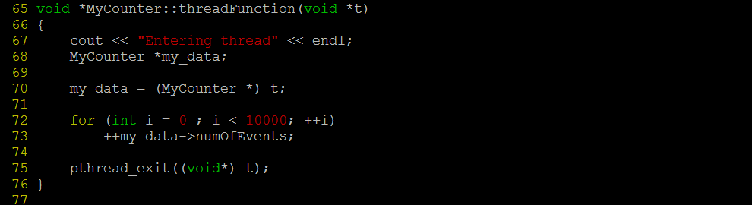

Thread function
Output?

Slide 25
Pthread Mutexes
Type: pthread_mutex_t
int pthread_mutex_init(pthread_mutex_t *mutex,
const pthread_mutexattr_t *attr);
int pthread_mutex_destroy(pthread_mutex_t *mutex);
int pthread_mutex_lock(pthread_mutex_t *mutex);
int pthread_mutex_unlock(pthread_mutex_t *mutex);
int pthread_mutex_trylock(pthread_mutex_t *mutex);
Attributes: for shared mutexes/condition vars among processes, for priority inheritance, etc.
use defaults
Important: Mutex scope must be visible to all threads!

Slide 26
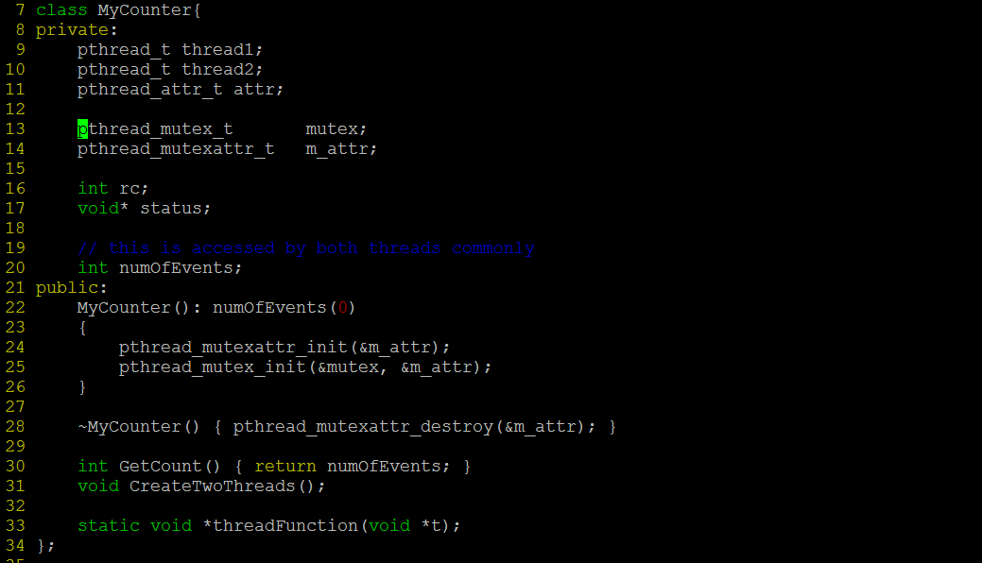
Using mutex

Slide 27
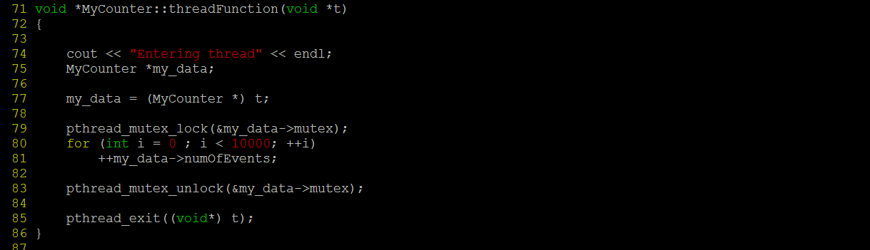
Using mutex in the thread function
Output?

Slide 28
Condition variables
Type pthread_cond_t
int pthread_cond_init(pthread_cond_t *cond,
const pthread_condattr_t *attr);
int pthread_cond_destroy(pthread_cond_t *cond);
int pthread_cond_wait(pthread_cond_t *cond,
pthread_mutex_t *mutex);
int pthread_cond_singal(pthread_cond_t *cond);
int pthread_cond_broadcast(pthread_cond_t *cond);

Slide 29
Pros and Cons of Thread-Based Designs
+ Easy to share data structures between threads
E.g., logging information, file cache
+ Threads are more efficient than processes
– Unintentional sharing can introduce subtle and hard-to-reproduce errors!
Ease of data sharing is greatest strength of threads
Also greatest weakness!

Slide 30
Thank you

